Slide 1
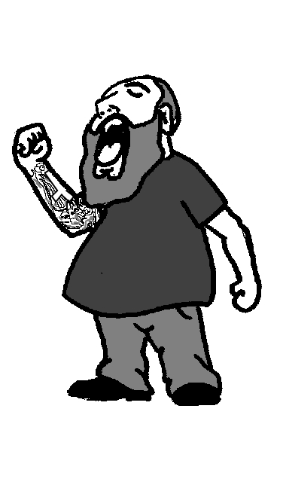
Defective Manding: Problem Behaviors and Beyond…
I WANT A
COOKIE!
Chris Wensil, BCaBA
Program Coordinator
Mariposa School for Children with Autism

Slide 2
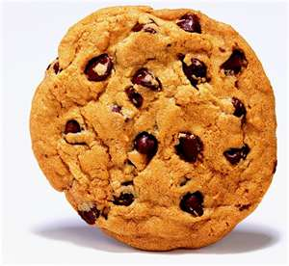
What is a Mand?
An elementary verbal operant that is evoked by an MO and is followed by specific reinforcement.(Cooper, 2007)
Our definition of a Mand for this evening: Asking for something because you want it!
There is specific reinforcement.
COOKIE

Slide 3
Why do we teach Manding?
So the child can get their needs and wants met in an appropriate manner.
To strengthen the adult as a conditioned reinforcer-the basis for social relationships
Often under conditions when the child can not effectively communicate their wants or needs they may engage in tantrum behavior or other problem behaviors(Hall & Sundberg, 1987)

Slide 4
Inappropriate Mands
Kids develop a manding reportiore. If we don’t teach them how to do it appropriately they will figure it out on their own!
Baby’s first Mand: Crying
As the child ages these inappropriate mands may turn into problem behavior including potentially severe and dangerous behavior

Slide 5
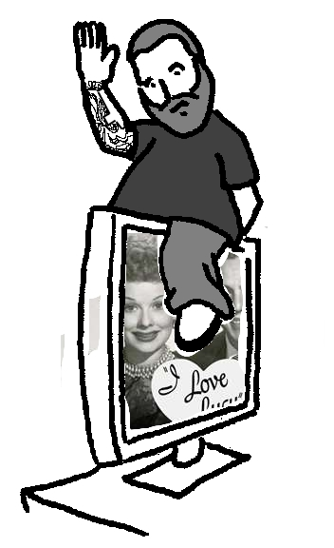
Examples of Problem Behaviors as a Mand
Climbing on the TV so Dad will
pick them up.
Hitting their brother so
they’re separated.
Screaming to get the radio
turned down.
Flopping on the floor, crying
and kicking because they
want a toy.

Slide 6
Other inappropriate mands
Tugging on a shirt to be picked up
Fingers in the ears to get a movie turned off.
WHINING!!!
Pointing and grunting to get a cracker.
Starring at a parent with their head tilted slightly to the right while whistling to get the Barney movie with the Pumpernickel bread song.

Slide 7
What are we gonna do about all this inappropriate manding?
Pick an appropriate response form-Signs, Vocals, stimulus-selection…
Extinction-we’re no longer going to reinforce those other behaviors
Replace those behaviors with appropriate communication

Slide 8
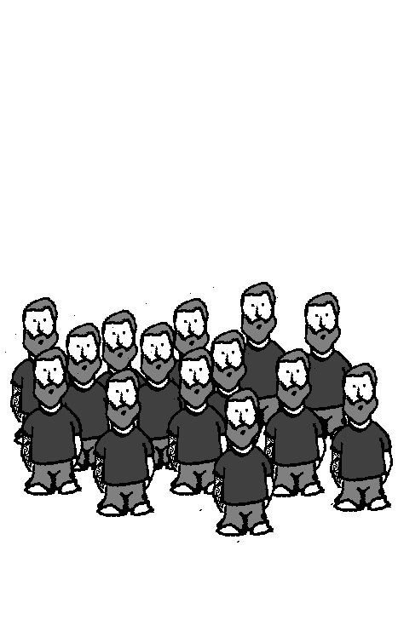
Repetitive Manding
When the child asks for something multiple times before it is or can be delivered.
Cause-History of reinforcement. Negative Reinforcement of Parent’s Behavior.
ball
ball
ball
ball
ball

Slide 9
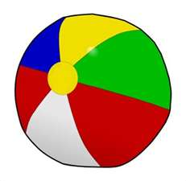
How to handle Repetitive Manding
First we need to stop the barrage of mands.
Create a behavior break. Time will do.
Prompt a single appropriate mand.
REINFORCE!

Slide 10
Scrolling
A common barrier faced by early language learners is the tendency to “guess” by emitting several words(or signs, or pictures) that were previously reinforced.
The primary cause of scrolling is that the response is never thoroughly brought under the correct control. Stimulus control not established
Unsuspecting adults may think the child is “self-correcting” and as a result inadvertently reinforce scrolling behavior.

Slide 11
What to do with Scrolling
Let’s stop the scroll.
Once again we need to create a behavior break. Especially important to be aware of chaining when dealing with scrolling.
Prompt and Reinforce!
Repeated trials will help strengthen the mand’s relationship with item or activity.

Slide 12
Improper Syntax and Rote Manding
If a child is required to exhibit the linguistic structure of his typical peers with disregard for the pre-requisite skills language will likely become rote and disordered (Carbone, 2007).
Children with only a few mands are often required to emit “I want” and “more” “please” “some” “I see” “I need” “a” “the” etc.
Some examples of what often results:

Slide 13
“more up” “more go” “more home”
“I want stop” “I want yes” “I want give me”
“I want a play” “I want the go”
“I need go” “I want turn it on” “can I want one?”
“I like to chip” “I want hungry”

Slide 14
Training more appropriate and functional language.
Get back to the basics!
Drop the extra stuff and remember manners only get you so far.
Focus on nouns and verbs!
ONE WORD IS OKAY!
Remember a child who is speaking in 5-6 word sentences have a vocabulary of several thousand words.

Slide 15
Unclear Mands(Articulation is poor)
Children often have weak articulation (both verbal and motor articulation).
Never established strong response.
Inadvertent reinforcement of weaker responses.
Incorrect response form. Are we using the correct form?

Slide 16
Treating unclear mands
Evaluate response form
A secondary or supplemental response form may be needed.
Establish reinforcer. Receptive discrimination may be necessary.
Shaping. Only accept the highest approximation when reinforcing.

Slide 17
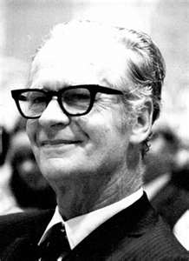
Overview
No longer accept incorrect or inappropriate mands
Prompt clear and appropriate mands in a response form that will keep the child successful.
Reinforce! If you want to see it again, REINFORCE.

